Slide 1
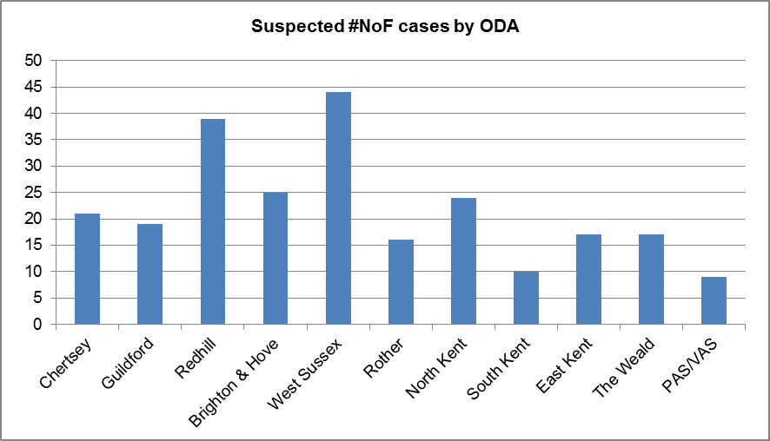
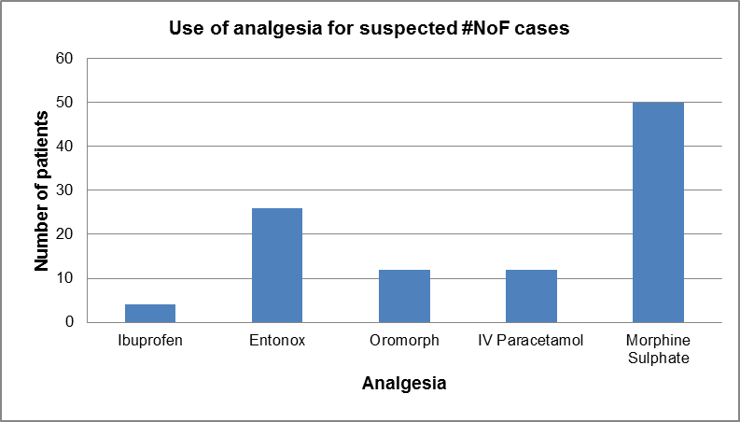
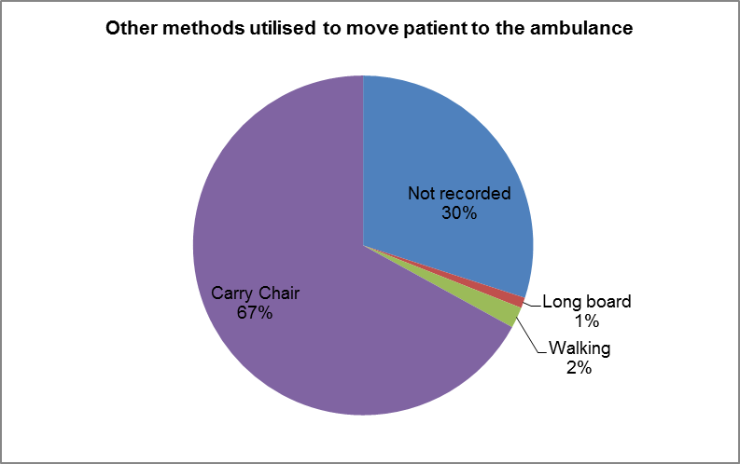
Fractured neck of femur clinical audit
Background
Fractured neck of femur (#NoF) is a relatively common presentation to the ambulance service (JRCALC, 2013) and SECAmb in particular, with over 300 incidents occurring over a three month period in 2013.
An audit was undertaken in 2011 to establish Trust compliance with national guidelines for falls assessment and prevention of #NoF. Findings from this audit advocated a re-audit in 2013 following implementation of the principal recommendations. However, the 2013 audit focus was shifted to specifically look at the clinical care delivered to patients identified with a suspected #NoF.
This poster highlights some of the key findings and learning points from the audit.
A total of 241 incidents were included in the audit between April – July 2013. This graph represents a breakdown of incidents per ODA.
Analgesia
Pain is a very common presentation in cases of #NoF, with over 68% of patients experiencing some degree of pain. Analgesia was administered in 62% of these cases, and ranged from simple ibuprofen to morphine sulphate.
Where morphine was administered, pain scores were seen to reduce on average by 3 points, based on a subjective numerical assessment of pain.
Remember; assess pain using the Trust pain management ladder and document pre and post intervention pain scores on the PCR.
Key points in managing a suspected #NoF (JRCALC, 2013)
Assess the affected limb for shortening and rotation
Assess pain and administer appropriate analgesia (remember pre and post intervention pain scores)
Assess patients for dehydration and hypothermia where patients may have been exposed or on the floor for prolonged periods
Immobilise and splint limbs using fracture straps/padding/triangular bandages
Always move and transport suspected #NoF patients on a scoop/vac mat and ambulance trolley. Always try to avoid using the carry chair (where possible. E.g. unable to fit scoop in / patient does not want to lay flat due to pain).
In total, 62% of patients were transported to the ambulance using the scoop stretcher. The pie chart above shows the other methods used to transport a patient to the ambulance.
The use of the carry chair, longboard and walking patients are not advised where a #NoF is suspected (JRCALC, 2013). The scoop/vac mat is the best method of transporting patients to the ambulance.
The full clinical audit report can be found on the medical zone of the Trust website.
If you have any questions or queries, please contact clinical.audit@secamb.nhs.uk
Audit circulated Q1 2014/2015 by Clinical Audit Lead/Critical Care Paramedic

